Slide 1
Cell Division
Mitosis and Meiosis

Slide 2
Cell Growth and Division
Cells can grow at astonishing rates.
Some cells, like E-coli, can double their volume in 30 minutes and divide in 30 minutes
Ideal conditions of cell growth can never be maintained for very long.
*Cells grow until they come into contact with other cells.

Slide 3
Cell Growth and Division
Cell Division can be turned off and on.
Turns on when we have an injury, cut or bone break.
Cells at edge of injury grow fast - growth slows down as the injury becomes healed.

Slide 4
Cell Growth and Division
Some cells divide and grow very rapidly and some rarely divide.
Skin cells & cells of the Digestive Tract grow and divide throughout our life.
Cells of our Heart and Nervous System will do this only rarely.

Slide 5
Eukaryotic Chromosomes
Eukaryotic chromosomes –
-linear chromsomes
-every species has a different number of chromosomes
-composed of chromatin – a complex of DNA and proteins
-heterochromatin – not expressed
-euchromatin – expressed regions

Slide 6
Eukaryotic Chromosomes
Chromosomes are very long and must be condensed to fit within the nucleus.
-nucleosome – DNA wrapped around a core of 8 histone proteins
-nucleosomes are spaced 200 nucleotides apart along the DNA
-further coiling creates the 30-nm fiber or solenoid

Slide 7
karyotype: the particular array of chromosomes of an organism

Slide 8
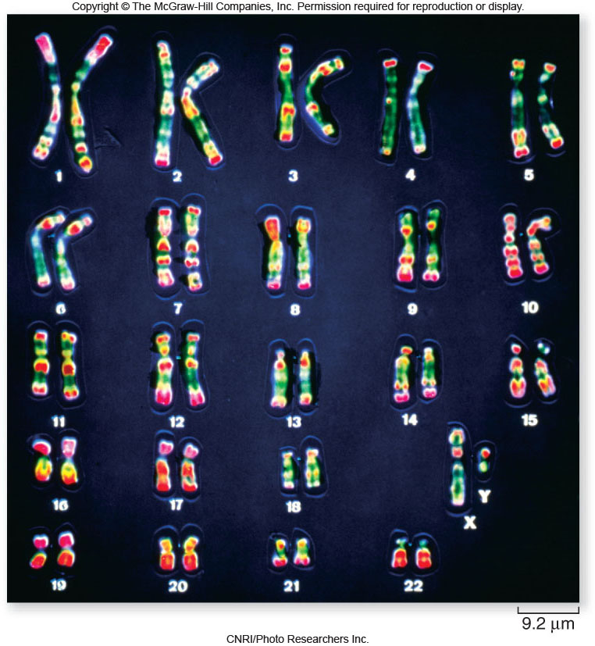

Slide 9
Eukaryotic Chromosomes
Chromosomes must be replicated before cell division.
-Replicated chromsomes are connected to each other at their kinetochores
-cohesin – complex of proteins holding replicated chromosomes together
-sister chromatids: 2 copies of the chromosome within the replicated chromosome

Slide 10
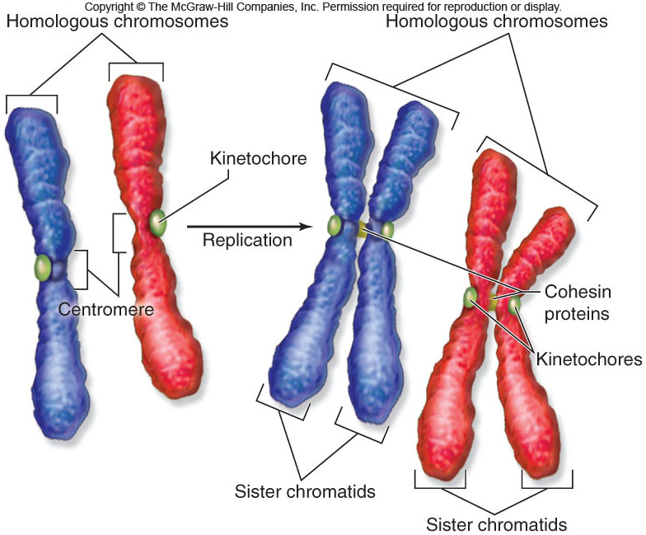

Slide 11
CELL DIVISION
A cell divides and produces two identical cells. (a mother cell splits in half to make two daughter cells that are genetically identical).

Slide 12
CELL DIVISION
Mitosis: The process in which the nucleus divides to produces two identical nuclei.
Cytokinesis: The process in which the cytoplasm divides to produces two new cells.

Slide 13
Eukaryotic Cell Cycle
The eukaryotic cell cycle has 5 main phases:
1. G₁ (gap phase 1)
2. S (synthesis)
3. G₂ (gap phase 2)
4. M (mitosis)
5. C (cytokinesis)
The length of a complete cell cycle varies greatly among cell types.
interphase

Slide 14
Mitosis
Mitosis is divided into 5 phases:
1. Interphase
2. Prophase
3. metaphase
4. anaphase
5. telophase

Slide 15
Interphase
Interphase is composed of:
G₁ (gap phase 1) – time of cell growth
S phase – synthesis of DNA (DNA replication)
- 2 sister chromatids are produced
G₂ (gap phase 2) – chromosomes condense

Slide 16
Interphase
Following S phase, the sister chromatids appear to share a centromere.
In fact, the centromere has been replicated but the 2 centromeres are held together by cohesin proteins.
Proteins of the kinetochore are attached to the centromere.
Microtubules attach to the kinetochore.

Slide 17
Interphase
1. Interphase: The period between cell division. (can be a long time).
The nucleus is active in producing messenger RNA. Proteins are made, and DNA is copied.

Slide 18
Mitosis
2. Prophase: Nuclear envelope disappears. chromosomes become visible. Centrioles move to opposites sides of the cell and form spindles (threads). Chromosomes replicate to form two chormatids connected in the middle by centromere.

Slide 19
Prophase

Slide 20
Metaphase
3. Metaphase: chromososmes line up in the middle of the cell. the spindles from the centrioles connect to the centromeres.

Slide 21
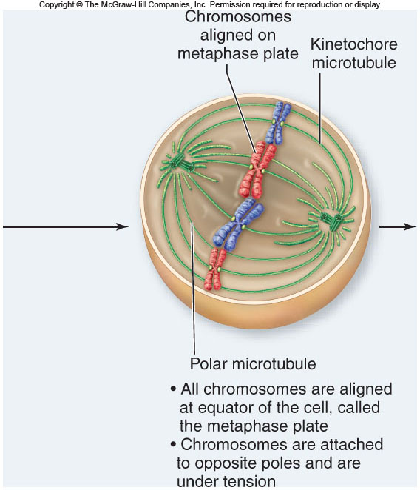

Slide 22
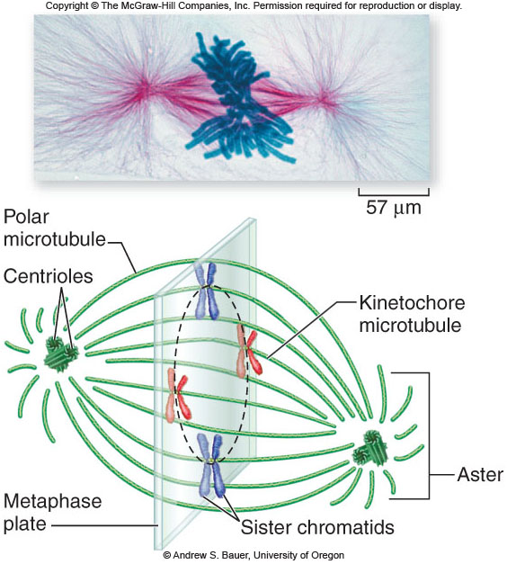

Slide 23
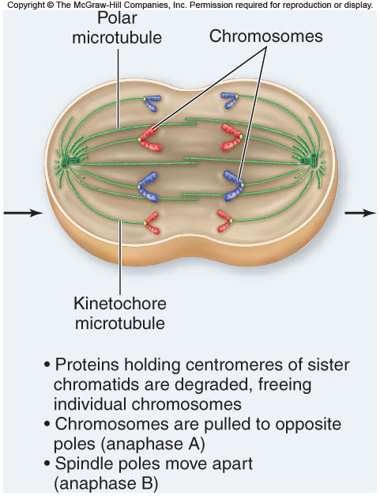
3. Metaphase: chromososmes line up in the middle of the cell. the spindles from the centrioles connect to the centromeres.

Slide 24
4. Anaphase: the two chromatids are pulled apart to opposites sides of the cell by the spindles. (once the chromatids are pulled apart, they are called chromosomes).

Slide 25
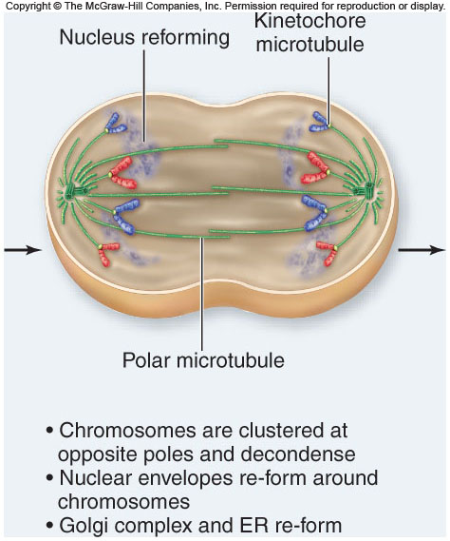
5. Telephase: The final phase of mitosis. The chromosomes located at both sides of the cell uncoil and nuclear envelope reforms.

Slide 26
Cytokinesis:
Once the genetic material is divided in two (mitosis), the cell (Cytoplasm) now splits into two daughter cells.
In animals:; The cell membrane pinches in the middle to form two new cells.
In plants: A cell plates forms in the middle of the cell. A cell wall will form at the cell plate to form two new cells.

Slide 27
Chromosomes
Chromosomes = Structures that contain genetic information.
- Means colored body because when dye is added the Chromosomes pick up the color so we can see them.
- Made of material called Chromatin which is made up of DNA and Protein.
- Humans contain 46 chromosomes - 23 from each parent.

Slide 28
Chromosomes
Made up of two Chromatids. these are the large thread structures. Each Chromosome has 2.
The Chromatids are attached at an area called the Centromere.

Slide 29
Sexual Reproduction and Meiosis

Slide 31
The Process of Meiosis
Prophase I:
-chromosomes coil tighter
-nuclear envelope dissolves
-homologues become closely associated in synapsis
-crossing over occurs between non-sister chromatids

Slide 34
The Process of Meiosis
Metaphase I:
-terminal chiasmata hold homologues together following crossing over
-microtubules from opposite poles attach to each homologue, not each sister chromatid
-homologues are aligned at the metaphase plate side-by-side
-the orientation of each pair of homologues on the spindle is random

Slide 35
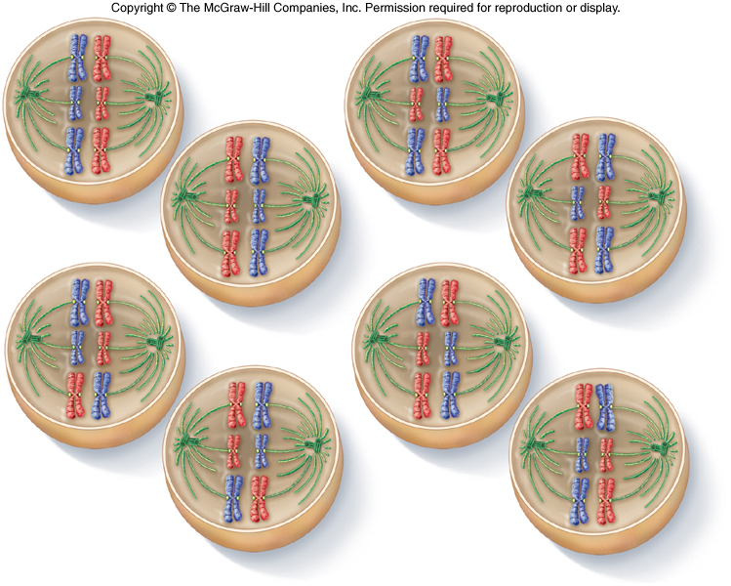

Slide 36
The Process of Meiosis
Anaphase I:
-microtubules of the spindle shorten
-homologues are separated from each other
-sister chromatids remain attached to each other at their centromeres

Slide 38
The Process of Meiosis
Telophase I:
-nuclear envelopes form around each set of chromosomes
-each new nucleus is now haploid
-sister chromatids are no longer identical because of crossing over

Slide 39
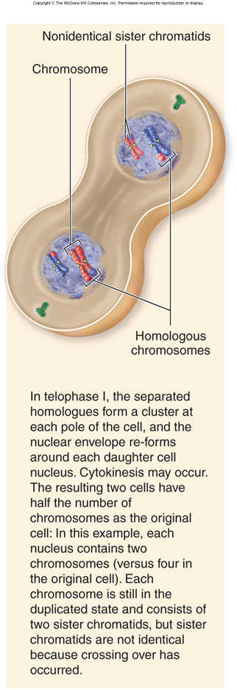

Slide 40
Meiosis II resembles a mitotic division:
-prophase II: nuclear envelopes dissolve and spindle apparatus forms
-metaphase II: chromosomes align on metaphase plate
-anaphase II: sister chromatids are separated from each other
-telophase II: nuclear envelope re-forms; cytokinesis follows

Slide 41
Meiosis is a form of cell division that leads to the production of gametes.
gametes: egg cells and sperm cells
-contain half the number of chromosomes of an adult body cell
Adult body cells (somatic cells) are diploid, containing 2 sets of chromosomes.
Gametes are haploid, containing only 1 set of chromosomes.

Slide 42
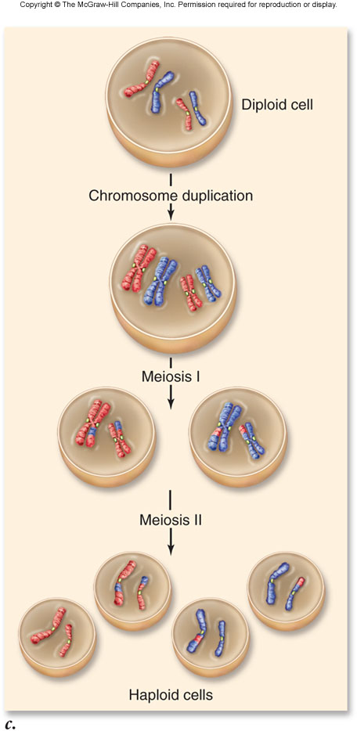

Slide 43
Sexual reproduction includes the fusion of gametes (fertilization) to produce a diploid zygote.
Life cycles of sexually reproducing organisms involve the alternation of haploid and diploid stages.
Some life cycles include longer diploid phases, some include longer haploid phases.

Slide 45
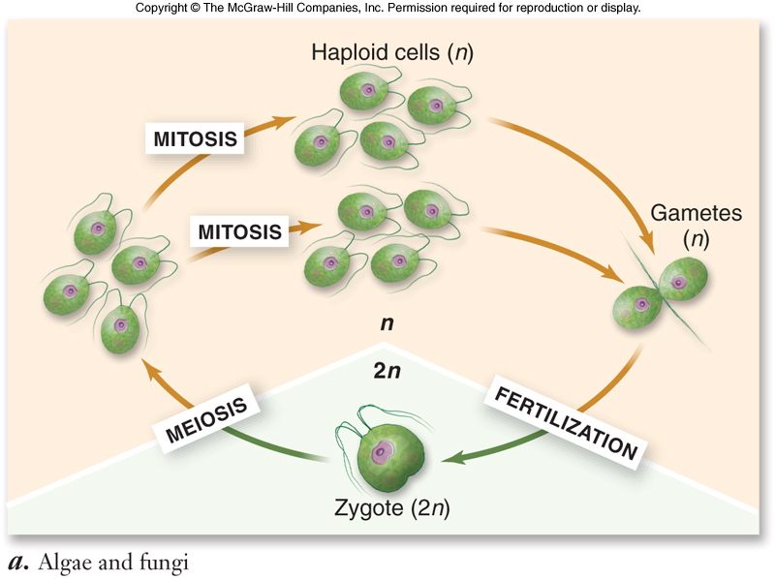

Slide 46
Uncontrolled Cell Growth
Cancer is caused by uncontrolled cell growth.
The cell growth is controlled by DNA.
The DNA is changed by viruses in many cases, causing the cell's chromosomes to be changed, altering their normal functions.
- These cells do not stop dividing when they come in contact with each other.

Slide 47
Bacterial Cell Division
Bacteria divide by binary fission.
-the single, circular bacterial chromosome is replicated
-replication begins at the origin of replication and proceeds bidirectionally
-new chromosomes are partitioned to opposite ends of the cell
-a septum forms to divide the cell into 2 cells

Slide 48
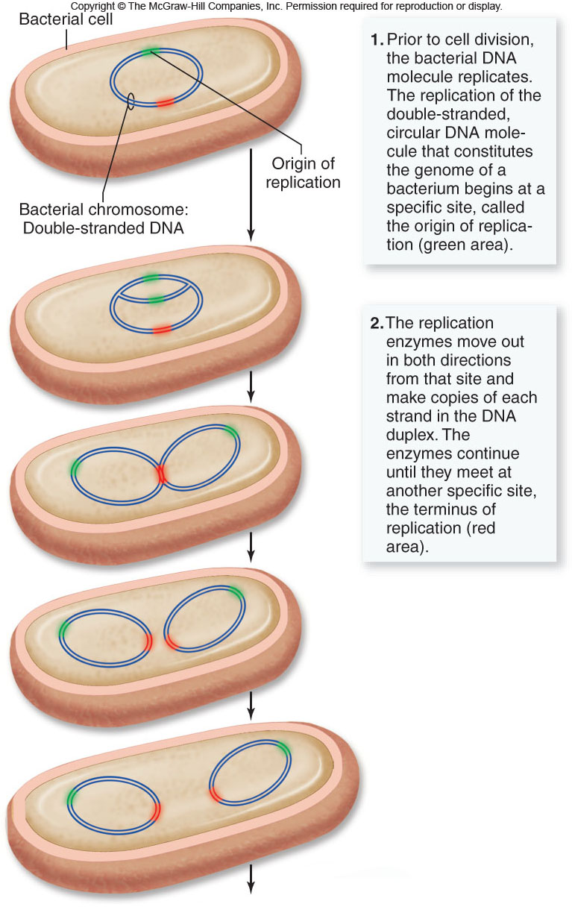

Slide 49
